Slide 1
By F. Ghavipanjeh fghavipanjeh@gmail.com

Slide 2
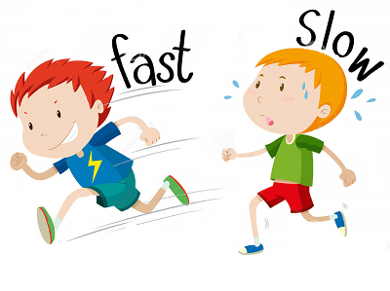
fast

Slide 3
slow

Slide 4
long

Slide 5
short

